Slide 1

Styling
With CSS
#3 CSS Grid

Slide 2
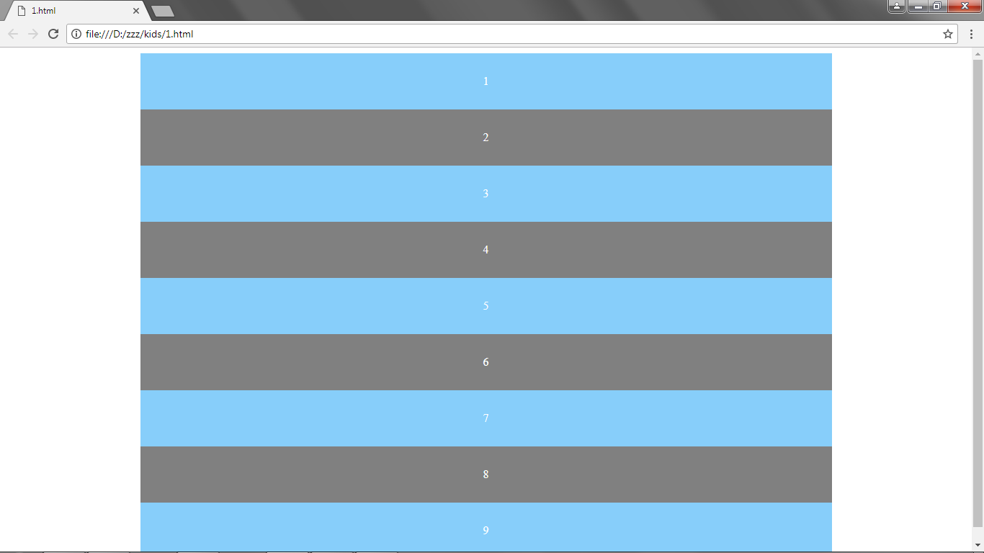

Slide 3
<body>
<div id="content">
<div class="kotak1">1</div>
<div class="kotak2">2</div>
<div class="kotak3">3</div>
<div class="kotak4">4</div>
<div class="kotak5">5</div>
<div class="kotak6">6</div>
<div class="kotak7">7</div>
<div class="kotak8">8</div>
<div class="kotak9">9</div>
</div>
</body>

Slide 4
<head><style>
body{
color: white;
text-align: center;
}
#content{
max-width: 960px;
margin: 0 auto;
}
#content div{
background: lightskyblue;
padding: 30px;
}
#content div:nth-child(even){
background: grey;
}
</style></head>

Slide 5
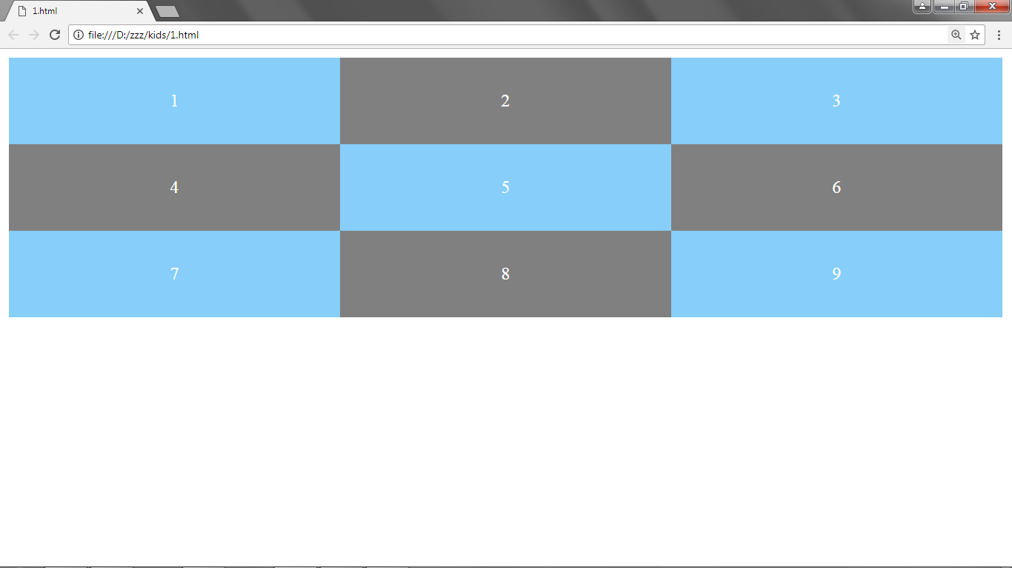
Template Columns

Slide 6
Template
Columns
#content{
display: grid;
grid-template-columns: 30% 30% 30%;
max-width: 960px;
margin: 0 auto;
}
= = = = = Using Fraction: = = = = =
grid-template-columns: 1fr 2fr 1fr;
= = = = = Using Repeat: = = = = =
grid-template-columns: repeat(3, 1fr);

Slide 7
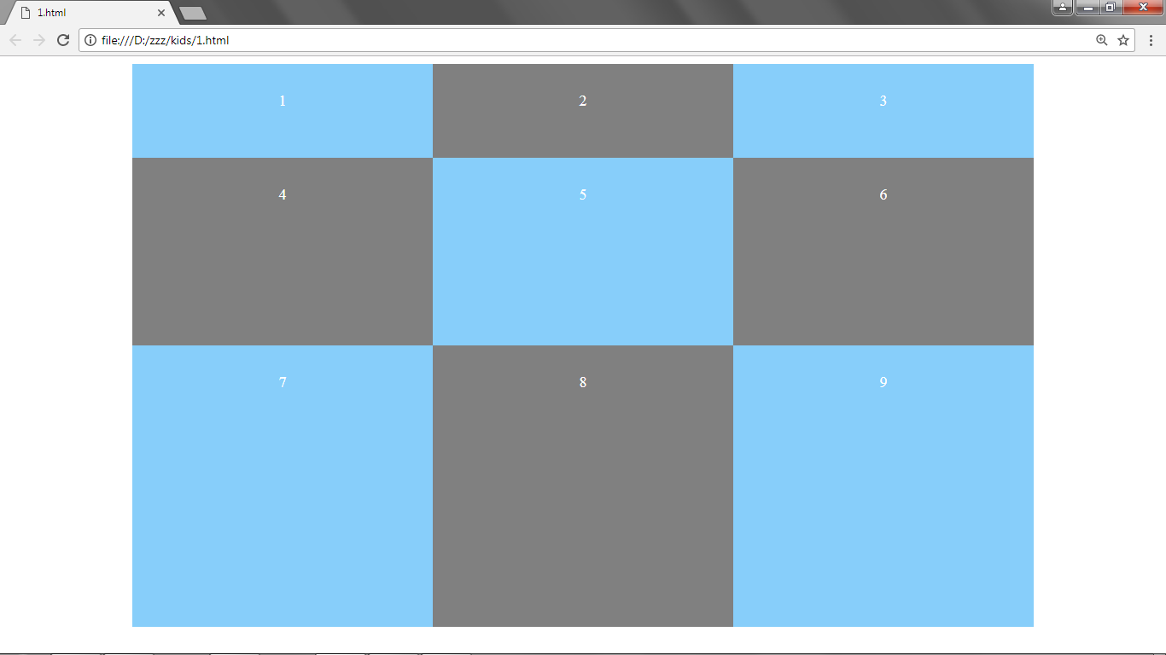
Template Rows

Slide 8
Template Rows
#content{
display: grid;
grid-template-columns: 1fr 1fr 1fr;
grid-template-rows: 100px 200px 300px;
max-width: 960px;
margin: 0 auto;
}
= = = = = Using Fraction: = = = = =
grid-template-rows: 1fr 2fr 1fr;
= = = = = Using Repeat: = = = = =
grid-template-rows: repeat(3, 1fr);

Slide 9
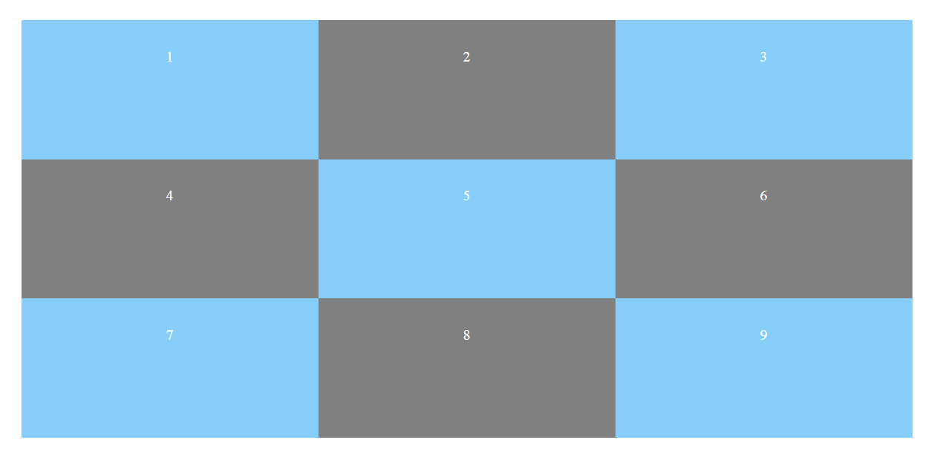
Auto Rows

Slide 10
Auto Rows
#content{
display: grid;
grid-template-columns: 1fr 1fr 1fr;
grid-auto-rows: 150px;
max-width: 960px;
margin: 0 auto;
}
= = = = = Using MinMax: = = = = =
grid-auto-rows: minmax(100px, auto);

Slide 11
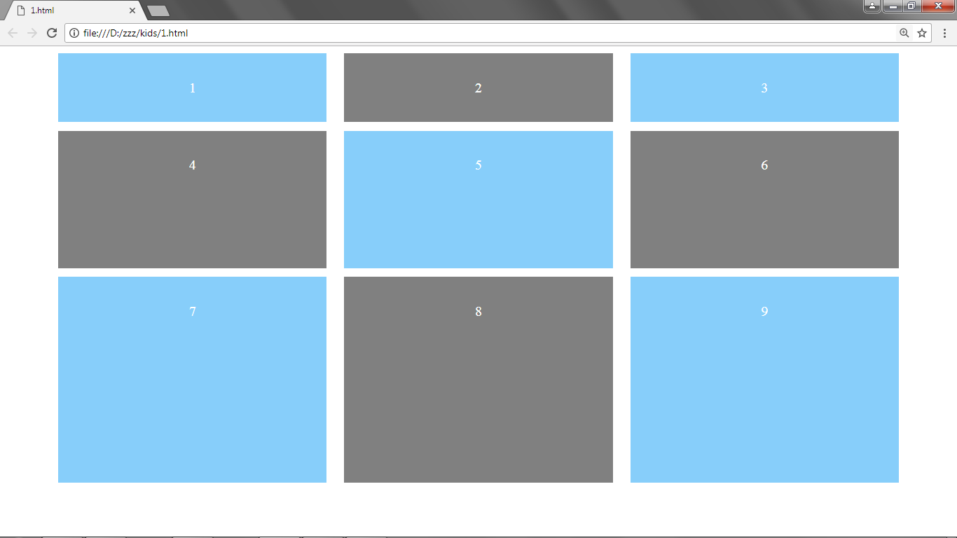
Grid Gap

Slide 12
Grid Gap
#content{
display: grid;
grid-template-columns: 1fr 1fr 1fr;
grid-template-rows: 1fr 2fr 3fr;
grid-column-gap: 20px;
grid-row-gap: 10px;
max-width: 960px;
margin: 0 auto;
}
// grid-gap: 20px;

Slide 13
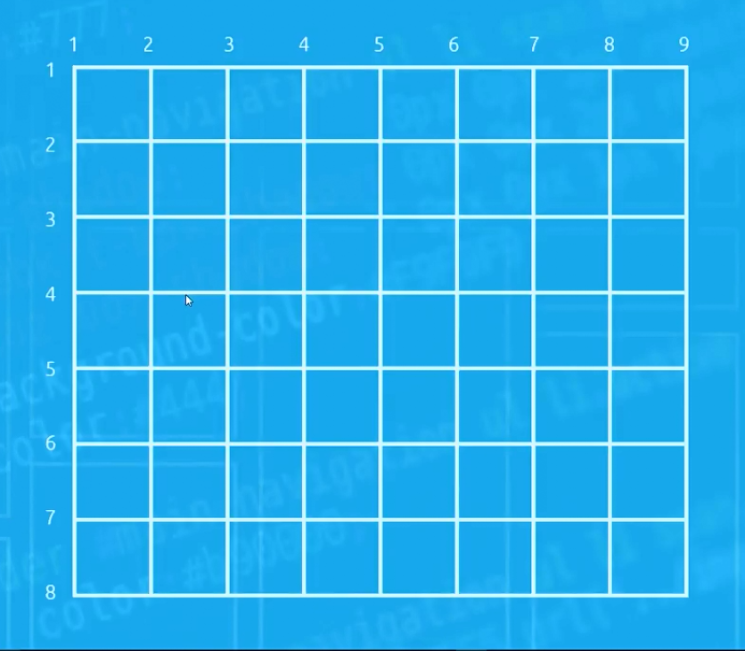
Grid Lines

Slide 14
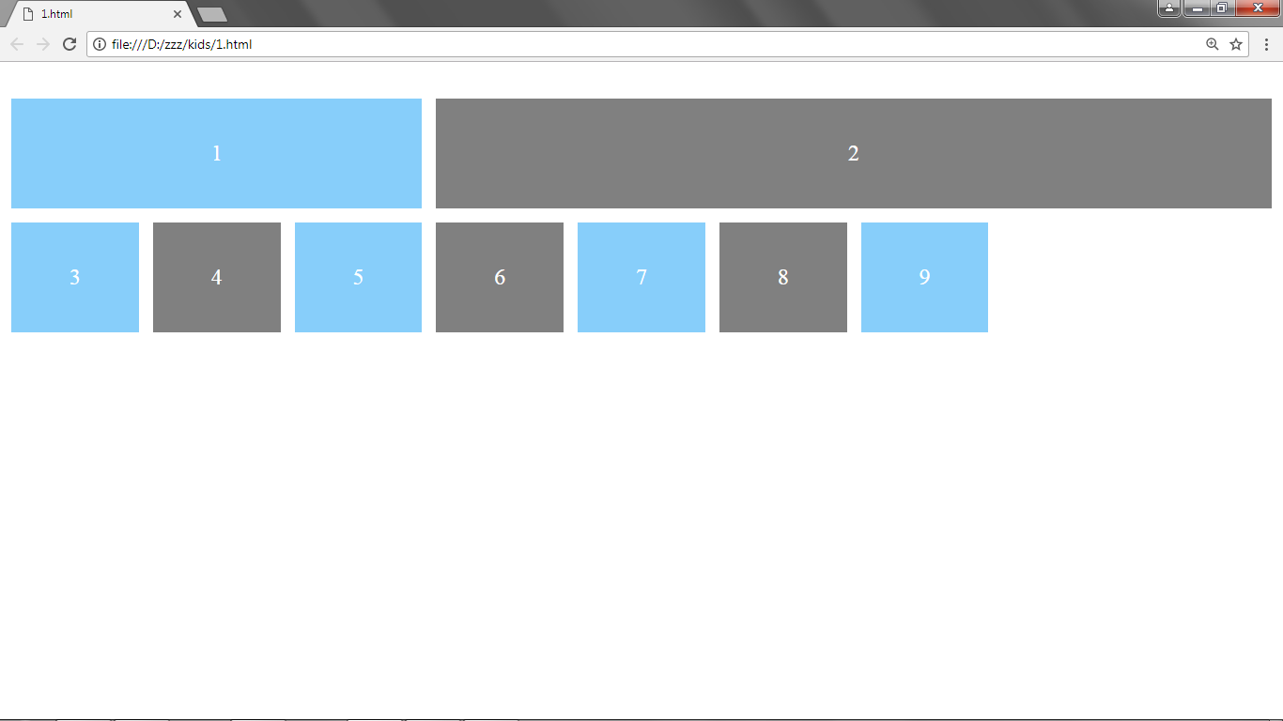
Grid Column

Slide 15
Grid Column
#content{
display: grid;
grid-template-columns: repeat(9, 1fr);
grid-template-rows: repeat(4, 1fr);
grid-gap: 10px;
max-width: 960px;
margin: 0 auto;
}
.kotak1 {
grid-column-start: 1;
grid-column-end: 4;
}
.kotak2 {
grid-column: 4 / 10;
}

Slide 16
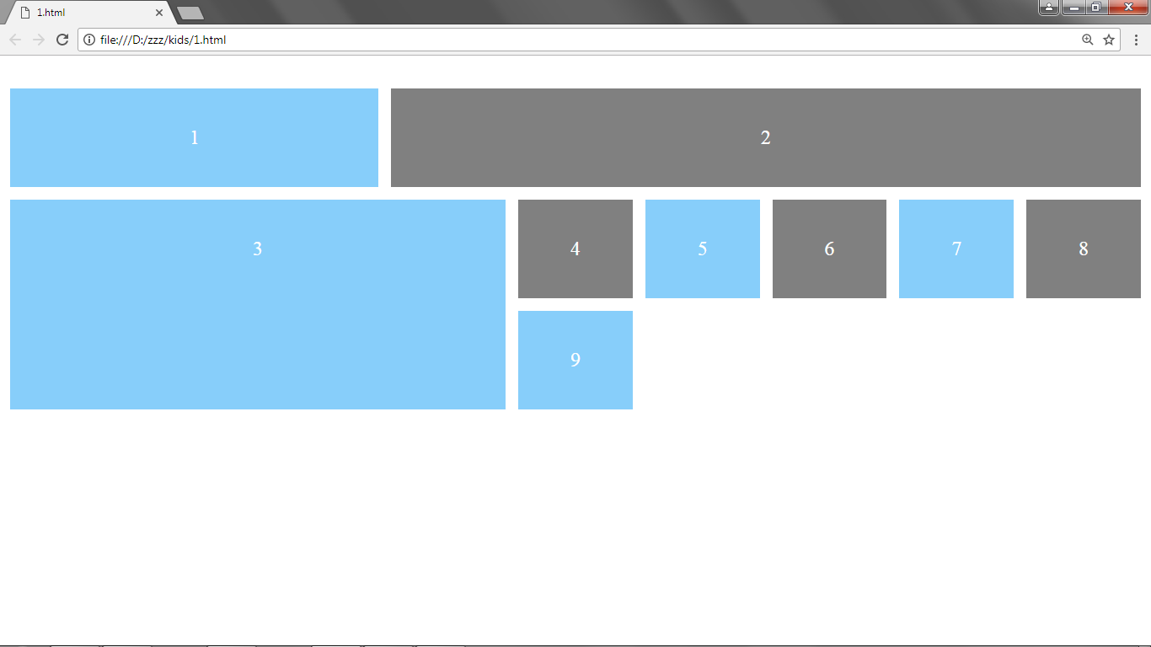
Grid Row

Slide 17
Grid Row
#content{
display: grid;
grid-template-columns: repeat(9, 1fr);
grid-template-rows: repeat(4, 1fr);
grid-gap: 10px;
max-width: 960px;
margin: 0 auto;
}
.kotak3 {
grid-column: 1 / 5;
grid-row: 2 / 4;
}

Slide 18
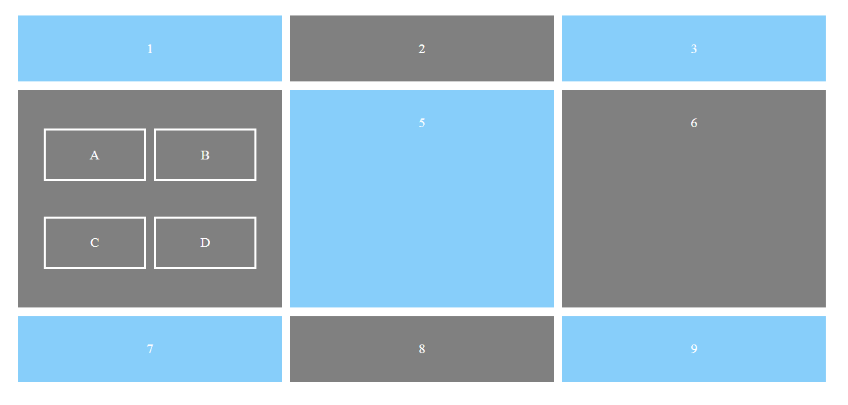
Nested Grids

Slide 19
Nested Grids
.kotak4 {
display: grid;
grid-template-columns: 1fr 1fr;
grid-gap: 10px;
}
.kotak4 p {
border: 2px solid white;
padding: 20px;
}
========================================
<div class="kotak4">
<p>A</p><p>B</p><p>C</p><p>D</p>
</div>

Slide 20
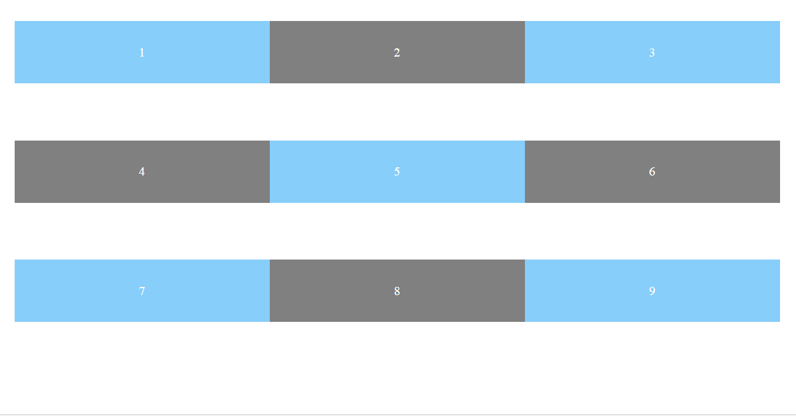
Align Items

Slide 21
Align Items
#content{
display: grid;
grid-template-columns: 1fr 1fr 1fr;
grid-auto-rows: 150px;
max-width: 960px;
margin: 0 auto;
align-items: start;
}
// align-items: stretch;
// align-items: end;
// align-items: center;

Slide 22
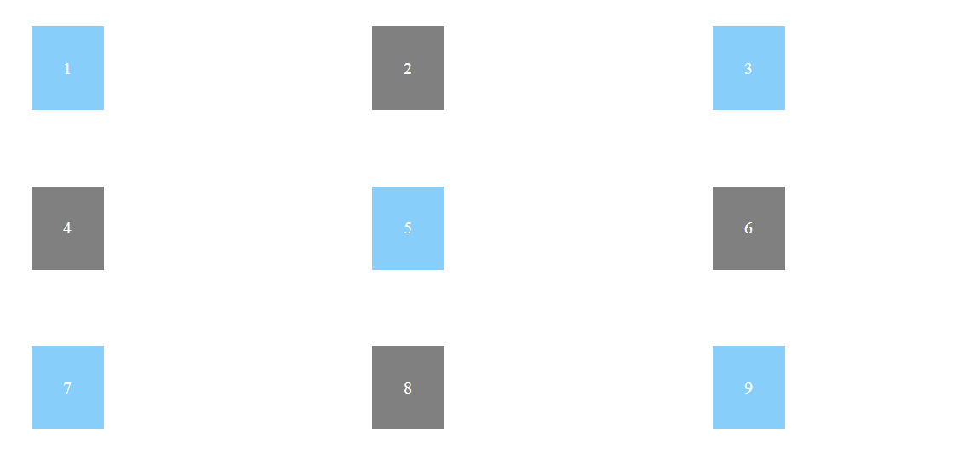
Justify Items

Slide 23
Justify Items
#content{
display: grid;
grid-template-columns: 1fr 1fr 1fr;
grid-auto-rows: 150px;
max-width: 960px;
margin: 0 auto;
align-items: start;
justify-items: start;
}
// justify-items: stretch;
// justify-items: end;
// justify-items: center;

Slide 24
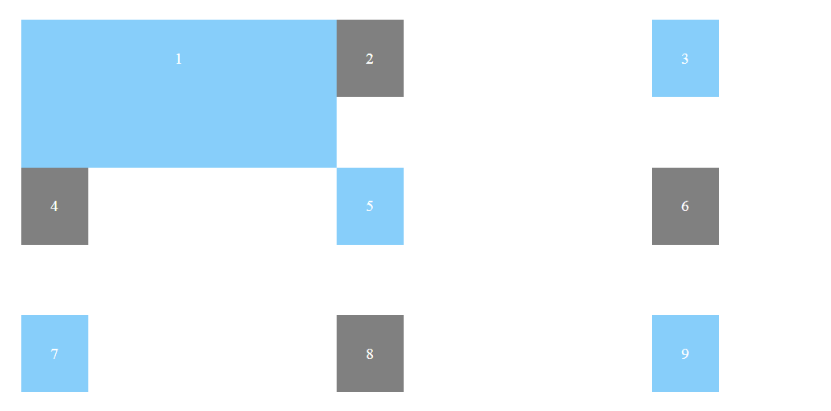
Align & Justify Self

Slide 25
Align & Justify Self
.kotak1{
align-self: stretch;
justify-self: stretch;
}
// align-self: start;
// justify-self: end;
// justify-self: center;

Slide 26
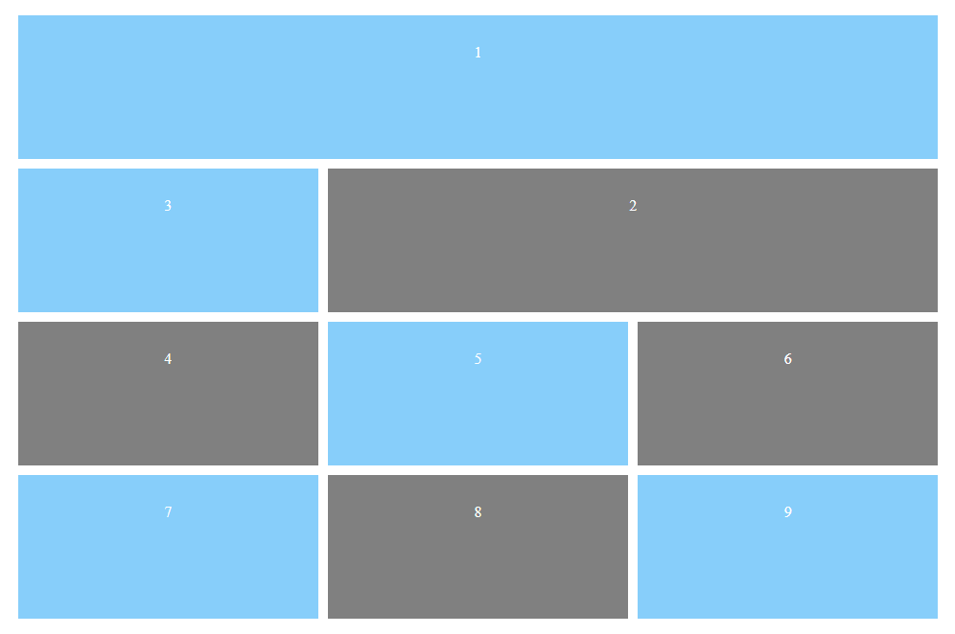
Grid Areas

Slide 27
Grid Areas
#content{
display: grid;
grid-template-columns: 1fr 1fr 1fr;
grid-auto-rows: 150px;
grid-gap: 10px;
max-width: 960px;
margin: 0 auto;
grid-template-areas:
"area1 area1 area1"
". area2 area2";
}
.kotak1{
grid-area: area1;}
.kotak2{
grid-area: area2;}

Slide 28
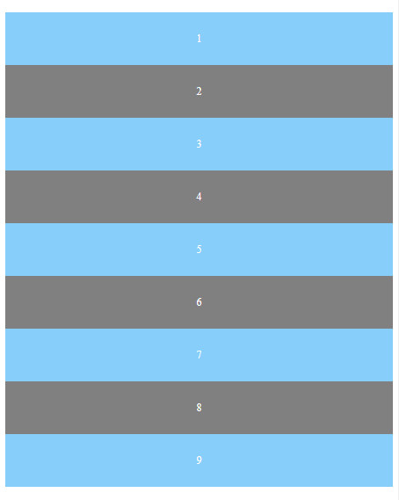
Responsive
<900px
>900px

Slide 29
@media screen and (min-width: 900px){
#content{
display: grid;
grid-template-columns: 1fr 1fr 1fr;
grid-auto-rows: 150px;
grid-gap: 10px;
max-width: 960px;
margin: 0 auto;
grid-template-areas:
"kotak1 kotak1 kotak1"
". kotak2 kotak2";
}}
.kotak1{
grid-area: kotak1;}
.kotak2{
grid-area: kotak2;}
Responsive

Slide 30
Styling
With CSS
#3 CSS Grid

